Slide 1

Prof. V. B. Shah Institute Of Management & R. V. Patel College Of Commerce (Eng. Med.) &
V. L. Shah College Of Commerce (Guj. Med.) &
Sutex Bank College Of Computer Application & Science
(Accredited ‘B’ (CGPA 2.55) by NAAC Dec.-2009)
VEER NARMAD SOUTH GUJARAT UNIVERSITY, SURAT
AIRSTRO
GUIDED BY:
Ms. Sanskruti Ramani
SUBMITTED BY:
647 – Nishil Chavda
658 – Deep Sorathiya
678 – Rahul Gadhiya

Slide 2

OVERVIEW
Project Profile
Project Overview
Admin/ User Features
Directory Structure
Diagrams
Data Dictionary
ScreenShots
Conclusion

Slide 3
PROJECT PROFILE
TITLE | AIRSTRO
FRONTEND | React.JS, Tailwind CSS
BACKEND | Node.JS, Express.JS
DATABASE | MongoDB
BROWSER | CHROME, FIREFOX, SAFARI
GUIDE BY | Ms. Sanskruti Ramani
SUBMITTED TO | Ms. Sanskruti Ramani

Slide 4
PROJECT OVERVIEW
The Airstro – Online Flight Booking System is a web-based platform developed using React.js, TailwindCSS, and JavaScript for the frontend, Node.js and Express.js for the backend, and MongoDB as the database.
The system allows users to register and log in to search for available flights, book flight tickets, view their bookings, and cancel them if required.
The Admin can manage and update flight details, such as scheduling, rescheduling, cancellation, and pricing through full CRUD operations.
The project supports two main roles: Admin and User, ensuring secure authentication and separate dashboards for each. Additionally, making online flight reservation faster and more user-friendly.

Slide 5
PROBLEM STATEMENT
In traditional flight booking, passengers often need to visit travel agencies or airline counters physically to check flight availability and purchase tickets. This process is time-consuming, inconvenient, and lacks transparency in pricing and schedule updates. Manual management of flight schedules makes it difficult for administrators to update flight information, which may lead to booking errors and miscommunication. Users cannot easily track their booking history or cancel tickets without lengthy procedures. There is no centralized system to manage flight details, user records, and booking data, which may result in data duplication, loss, or mismanagement. To overcome these issues, we developed a digital Online Flight Booking System – Airstro.

Slide 6
ADMIN FEATURES
Admin Panel
Login is required using admin email and password.
Admin can add new flights, update flight details, or delete flights.
Admin can view all flights available in the system.
Admin can view all user bookings along with passenger details.
Admin can update booking status or delete bookings if necessary.
Admin dashboard provides a centralized flight & booking management interface.

Slide 7
USER FEATURES
User Panel
Users can Register/Login using email and password for authentication.
Main navigation includes: Home, Deals & Offers, My Trips, About Us, Login, Signup
Home Page displays Hero section, booking widget, offers, and recommended destinations.
About Page describes Airstro’s mission and international network along with loyalty benefits.
Users can select a flight and complete the booking instantly.
My Trips Page displays:
All booked flights
Total fare
Booking status
Users can cancel flights anytime
Users cannot book or manage flights without logging in.

Slide 8
DIRECTORY STRUCTURE
AIRSTRO/
|
|── backend/
| |── config/
| |── controllers/
| |── middleware/
| |── models/
| |── routes/
| |── utils/
| |── uploads/
| |──.env
| |── package.json
| └── server.js
AIRSTRO/
|
|── frontend/
| |── public/
| |── src/
| | |── components/
| | |── pages/
| | |── services/
| | |── context/
| | |── assets/
| | └── App.jsx
| |── package.json
| └── vite.config.js

Slide 9
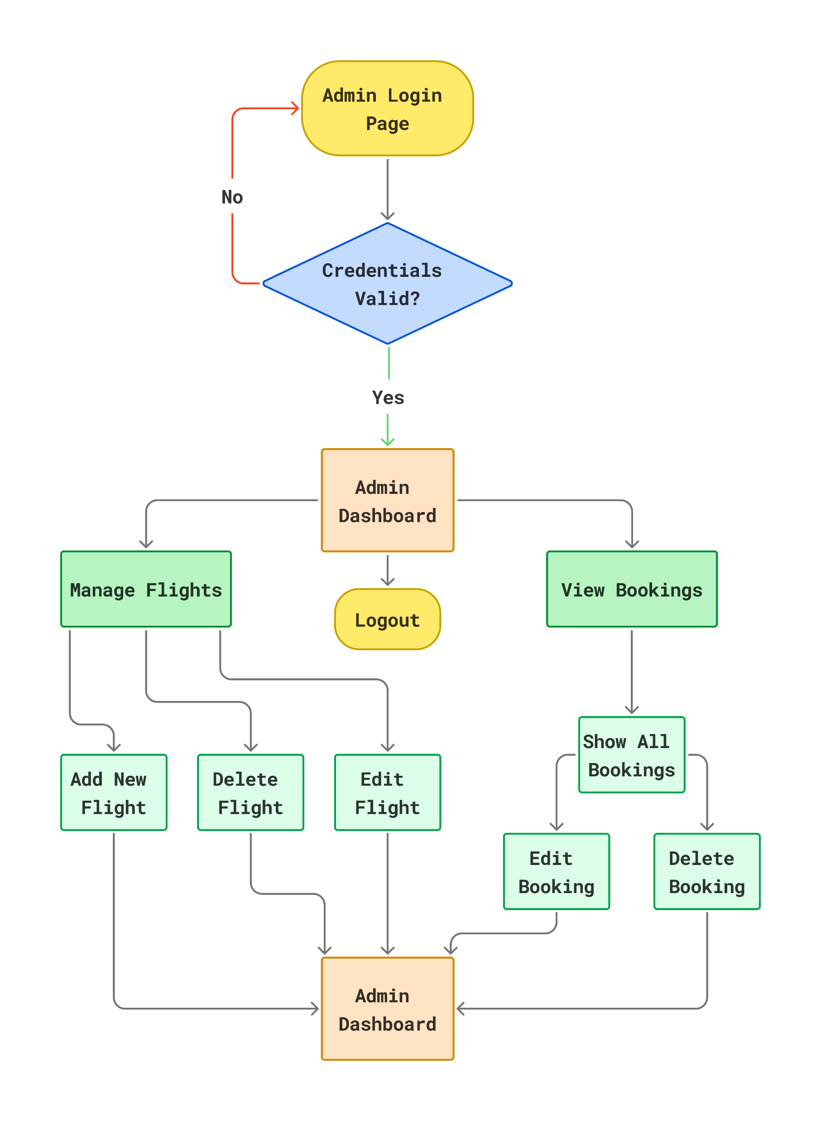
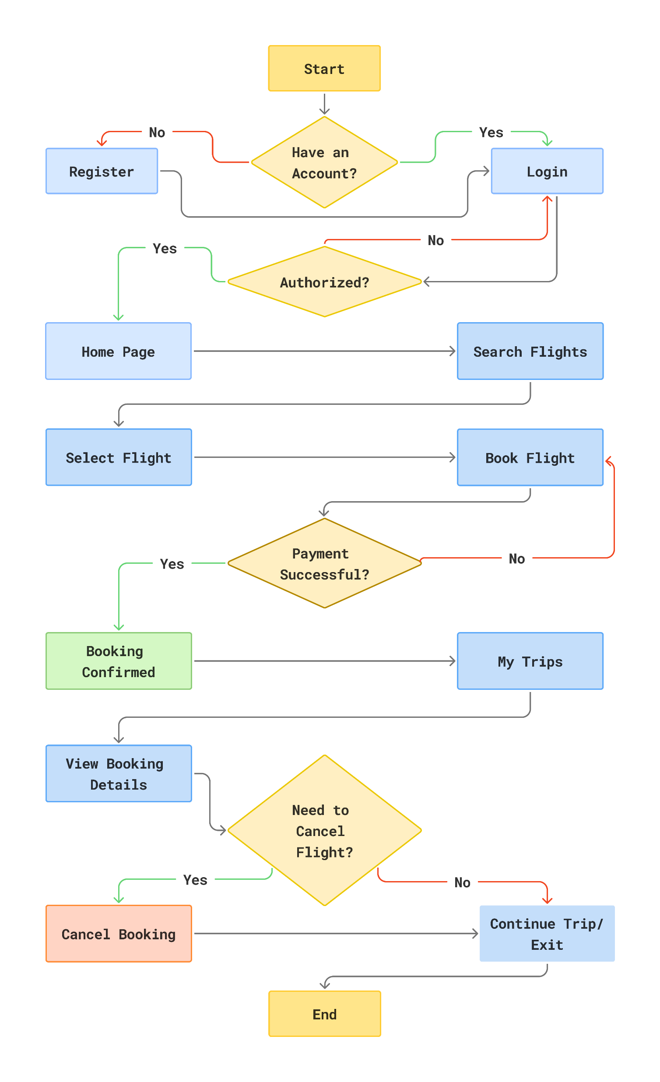
Admin/User Process Flow Diagram

Slide 10
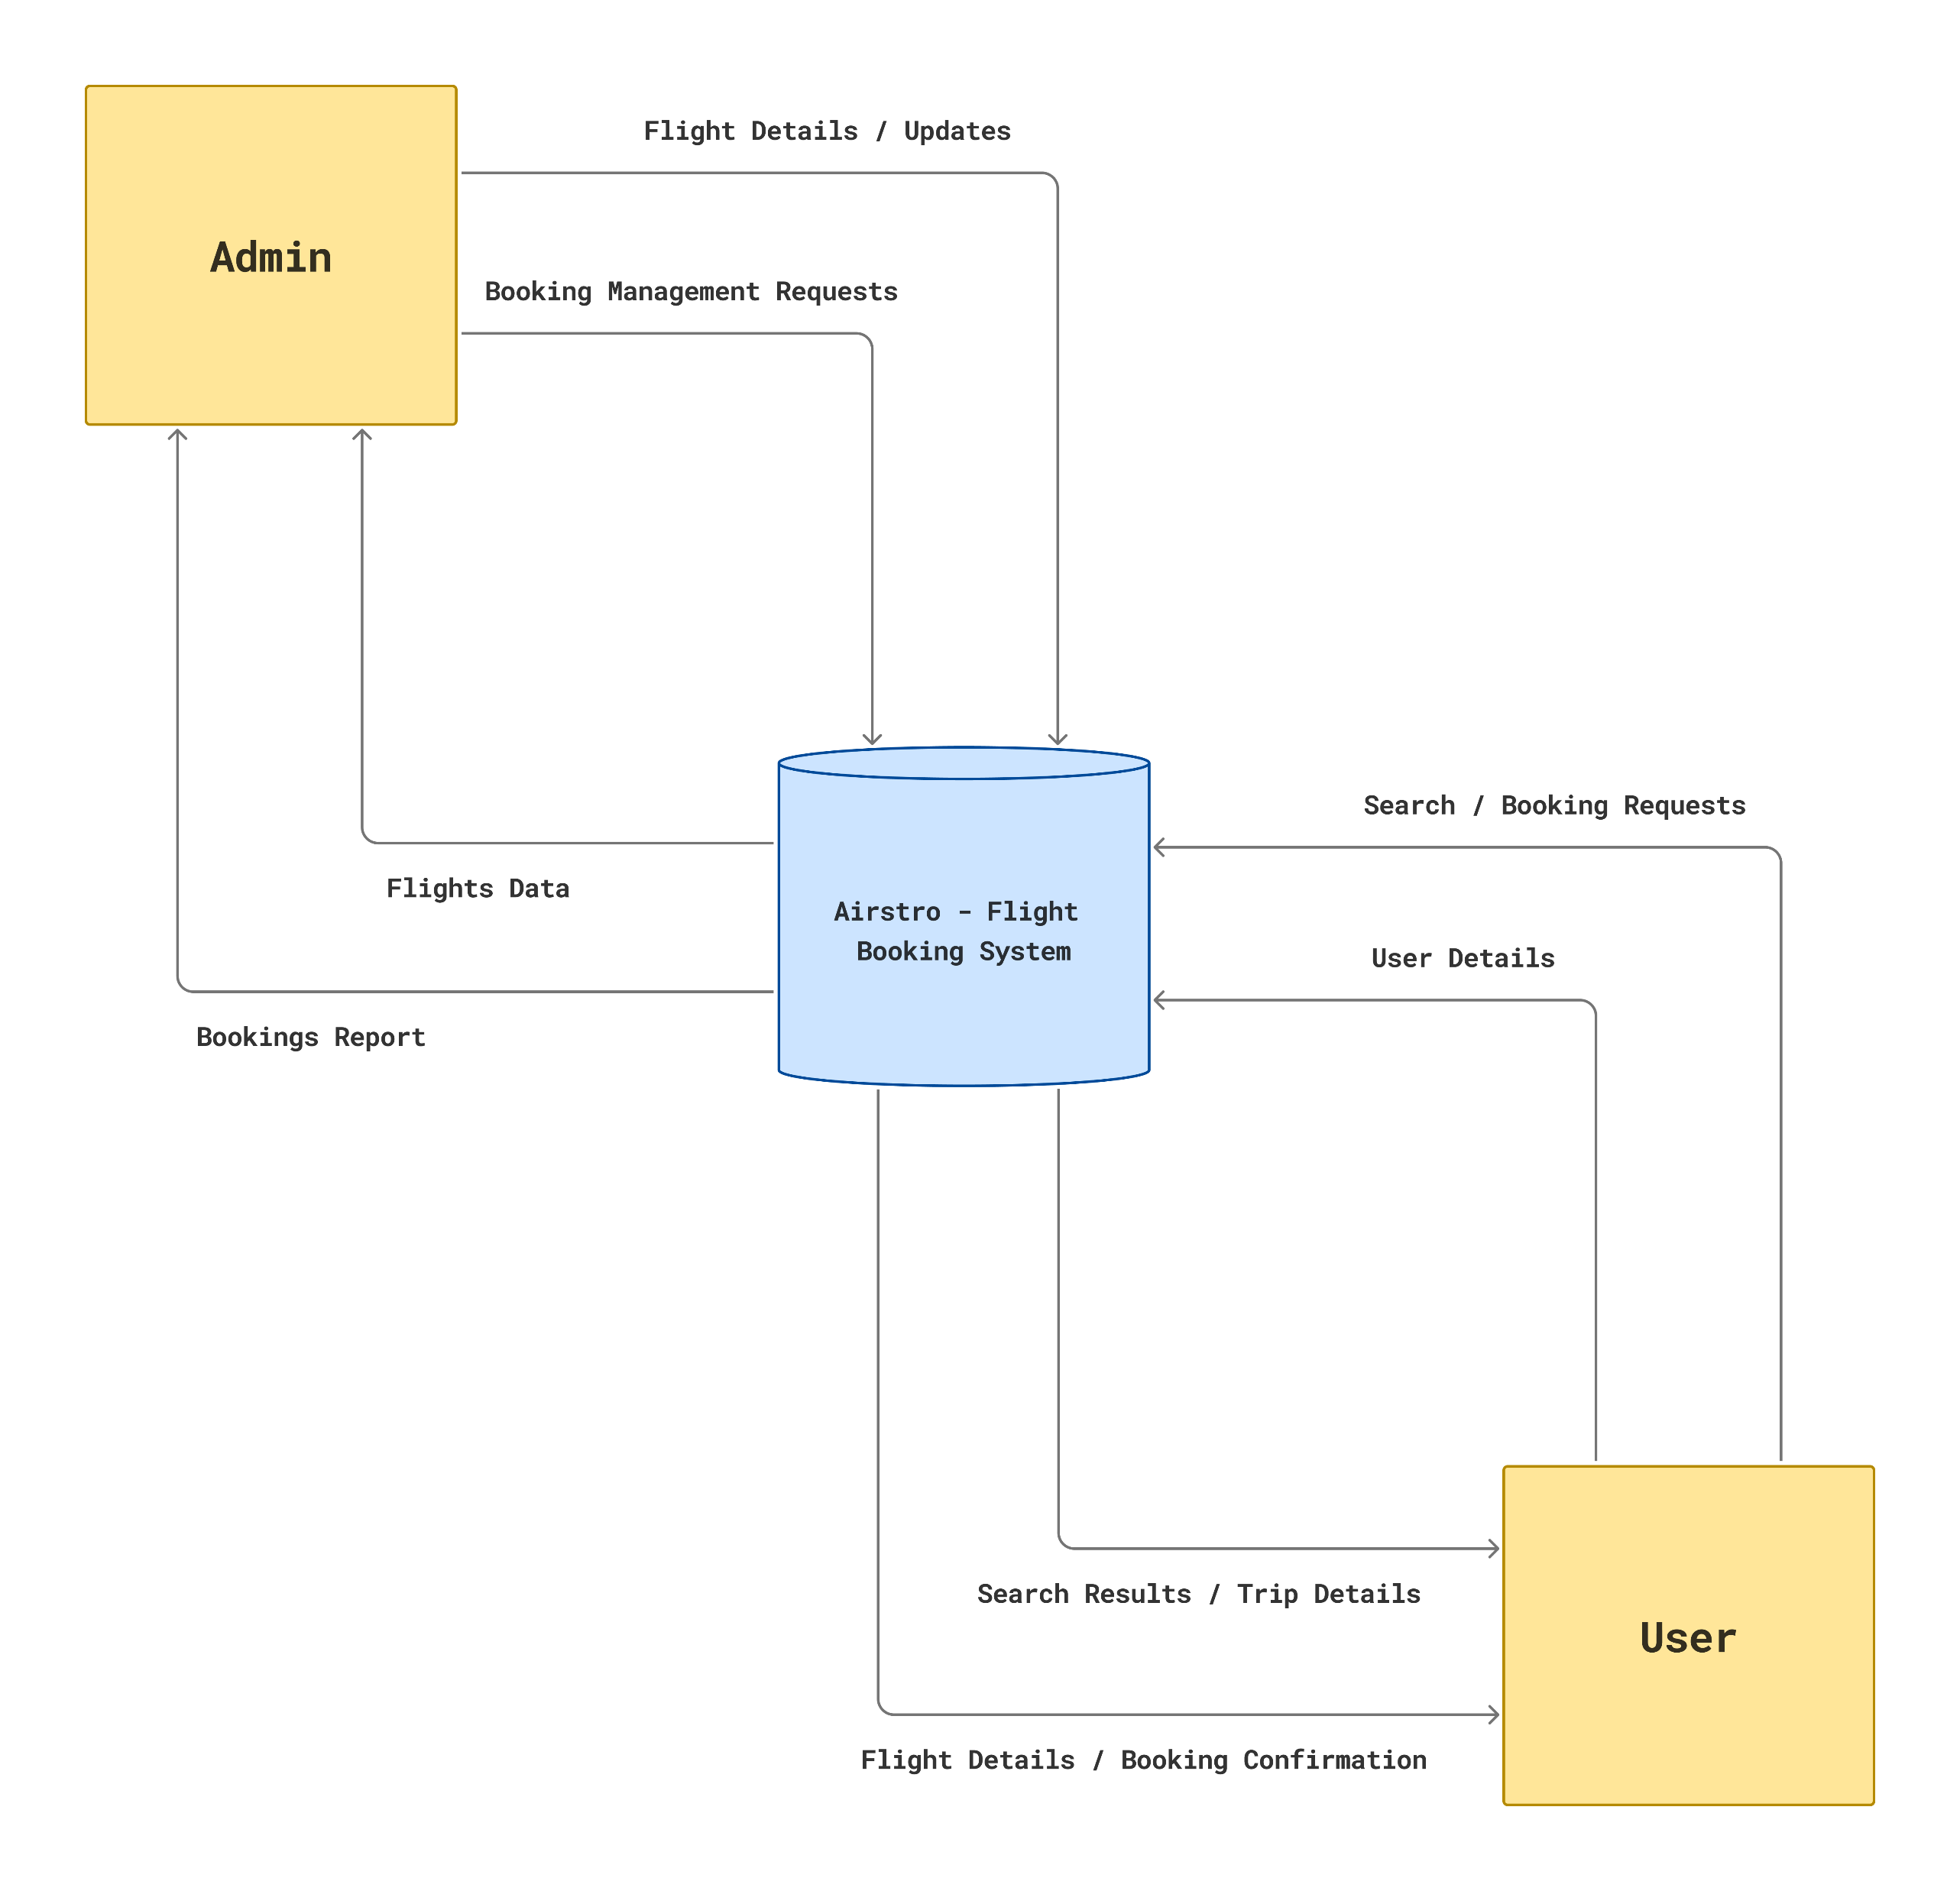
0 Level Diagram (Context Diagram)

Slide 11
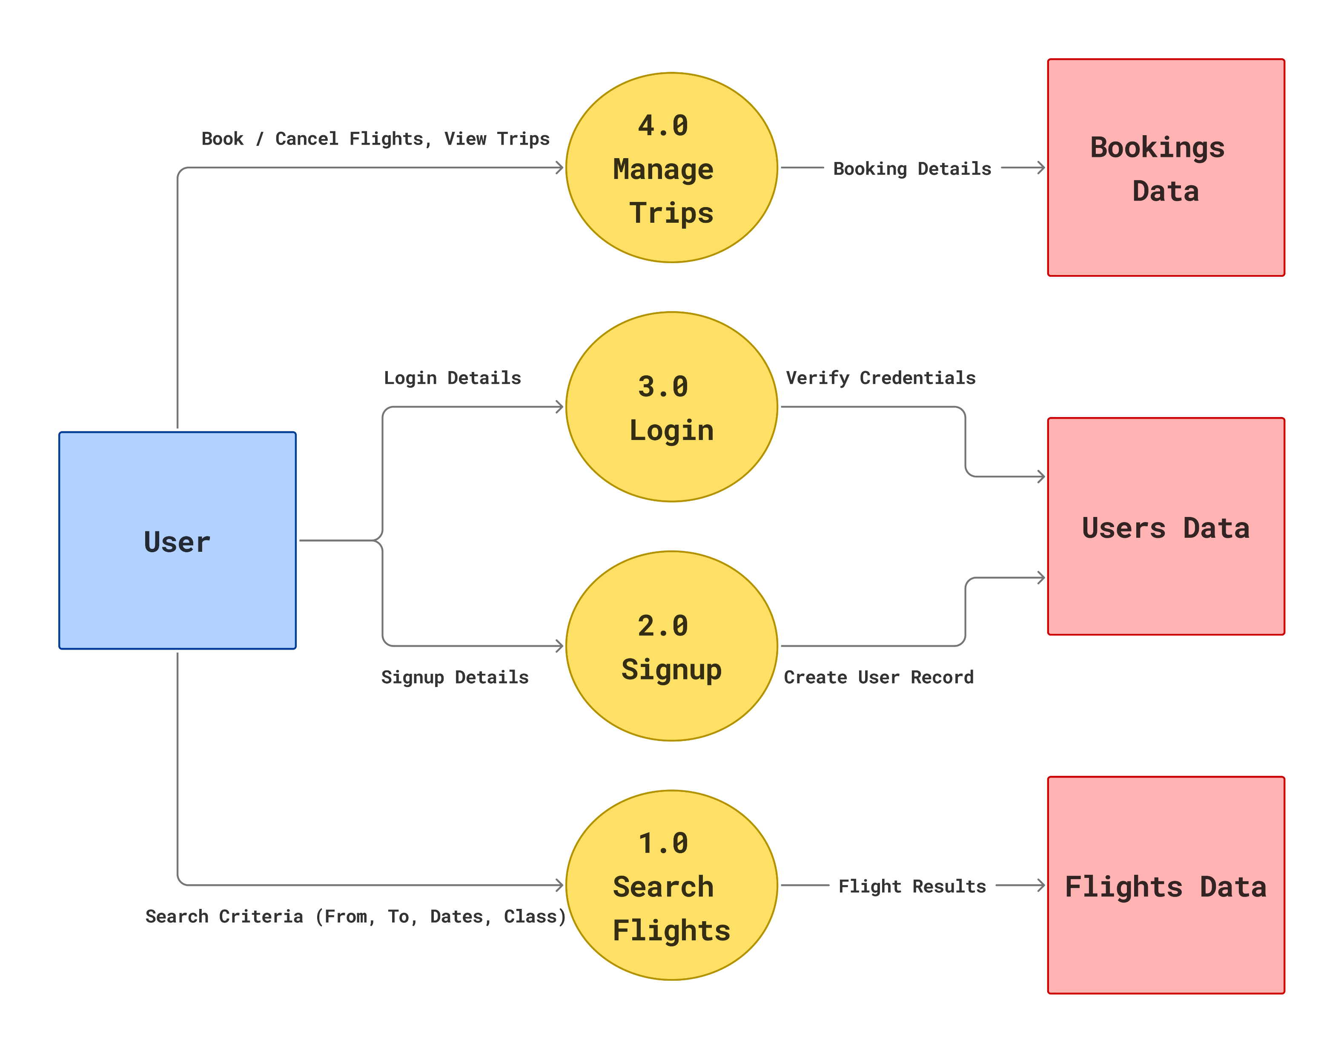
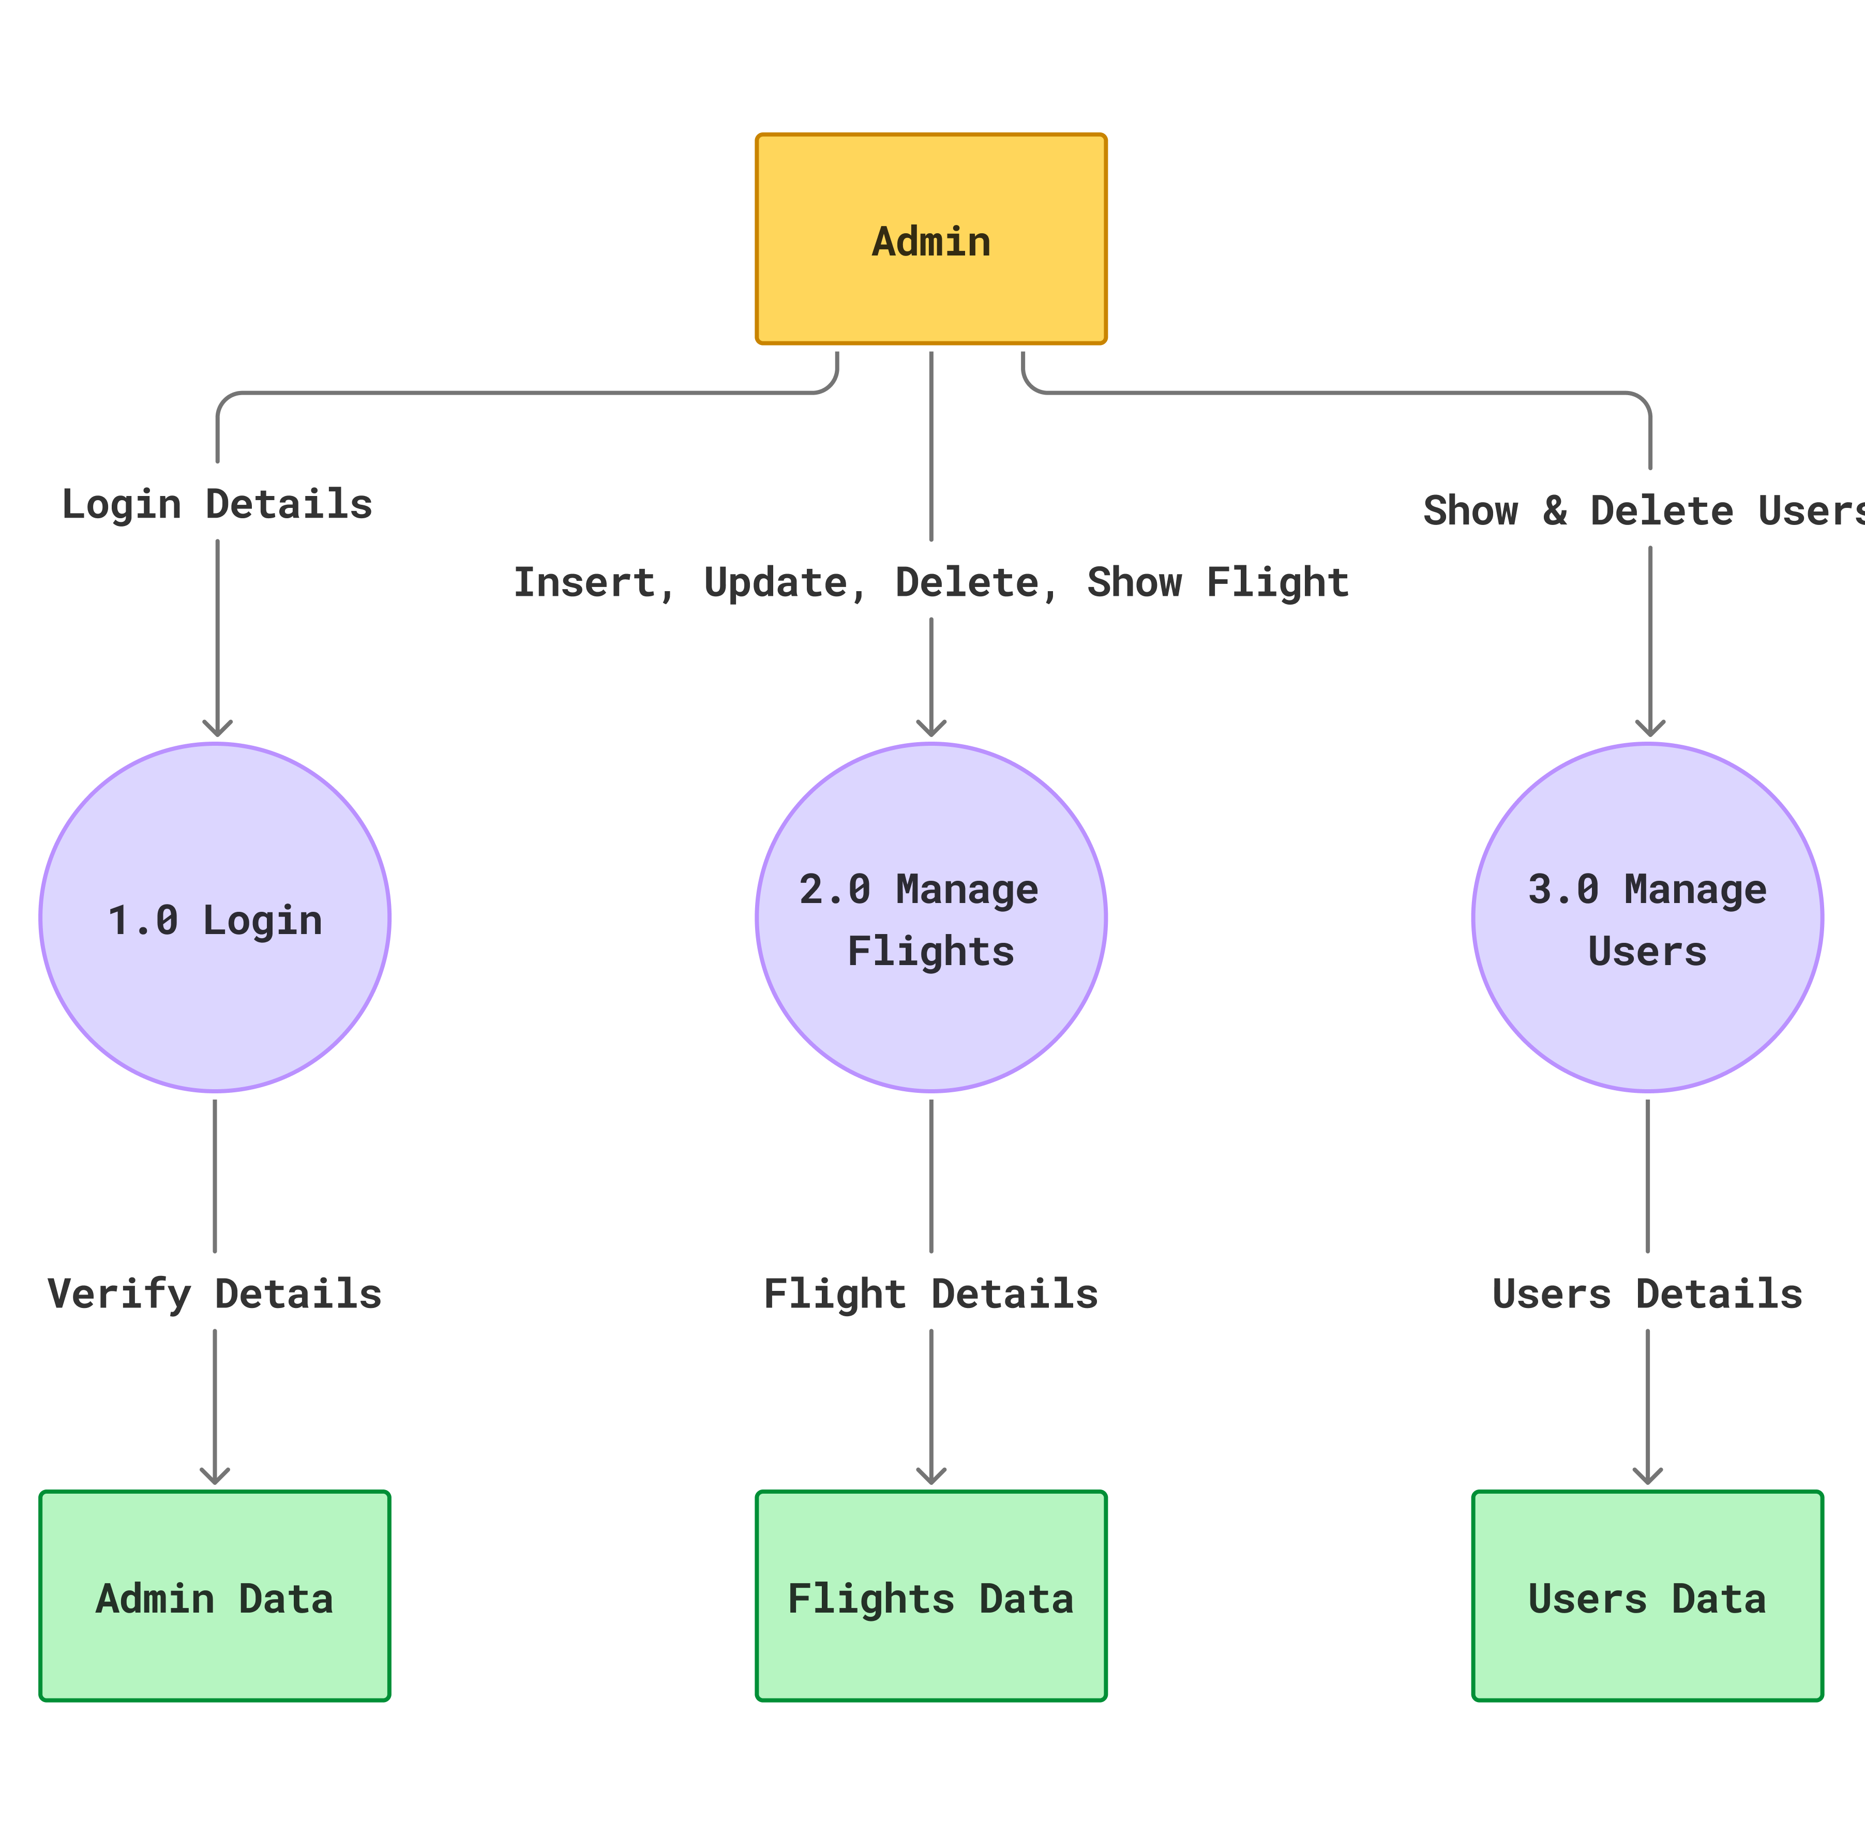
1 Level Admin/User Diagram

Slide 12
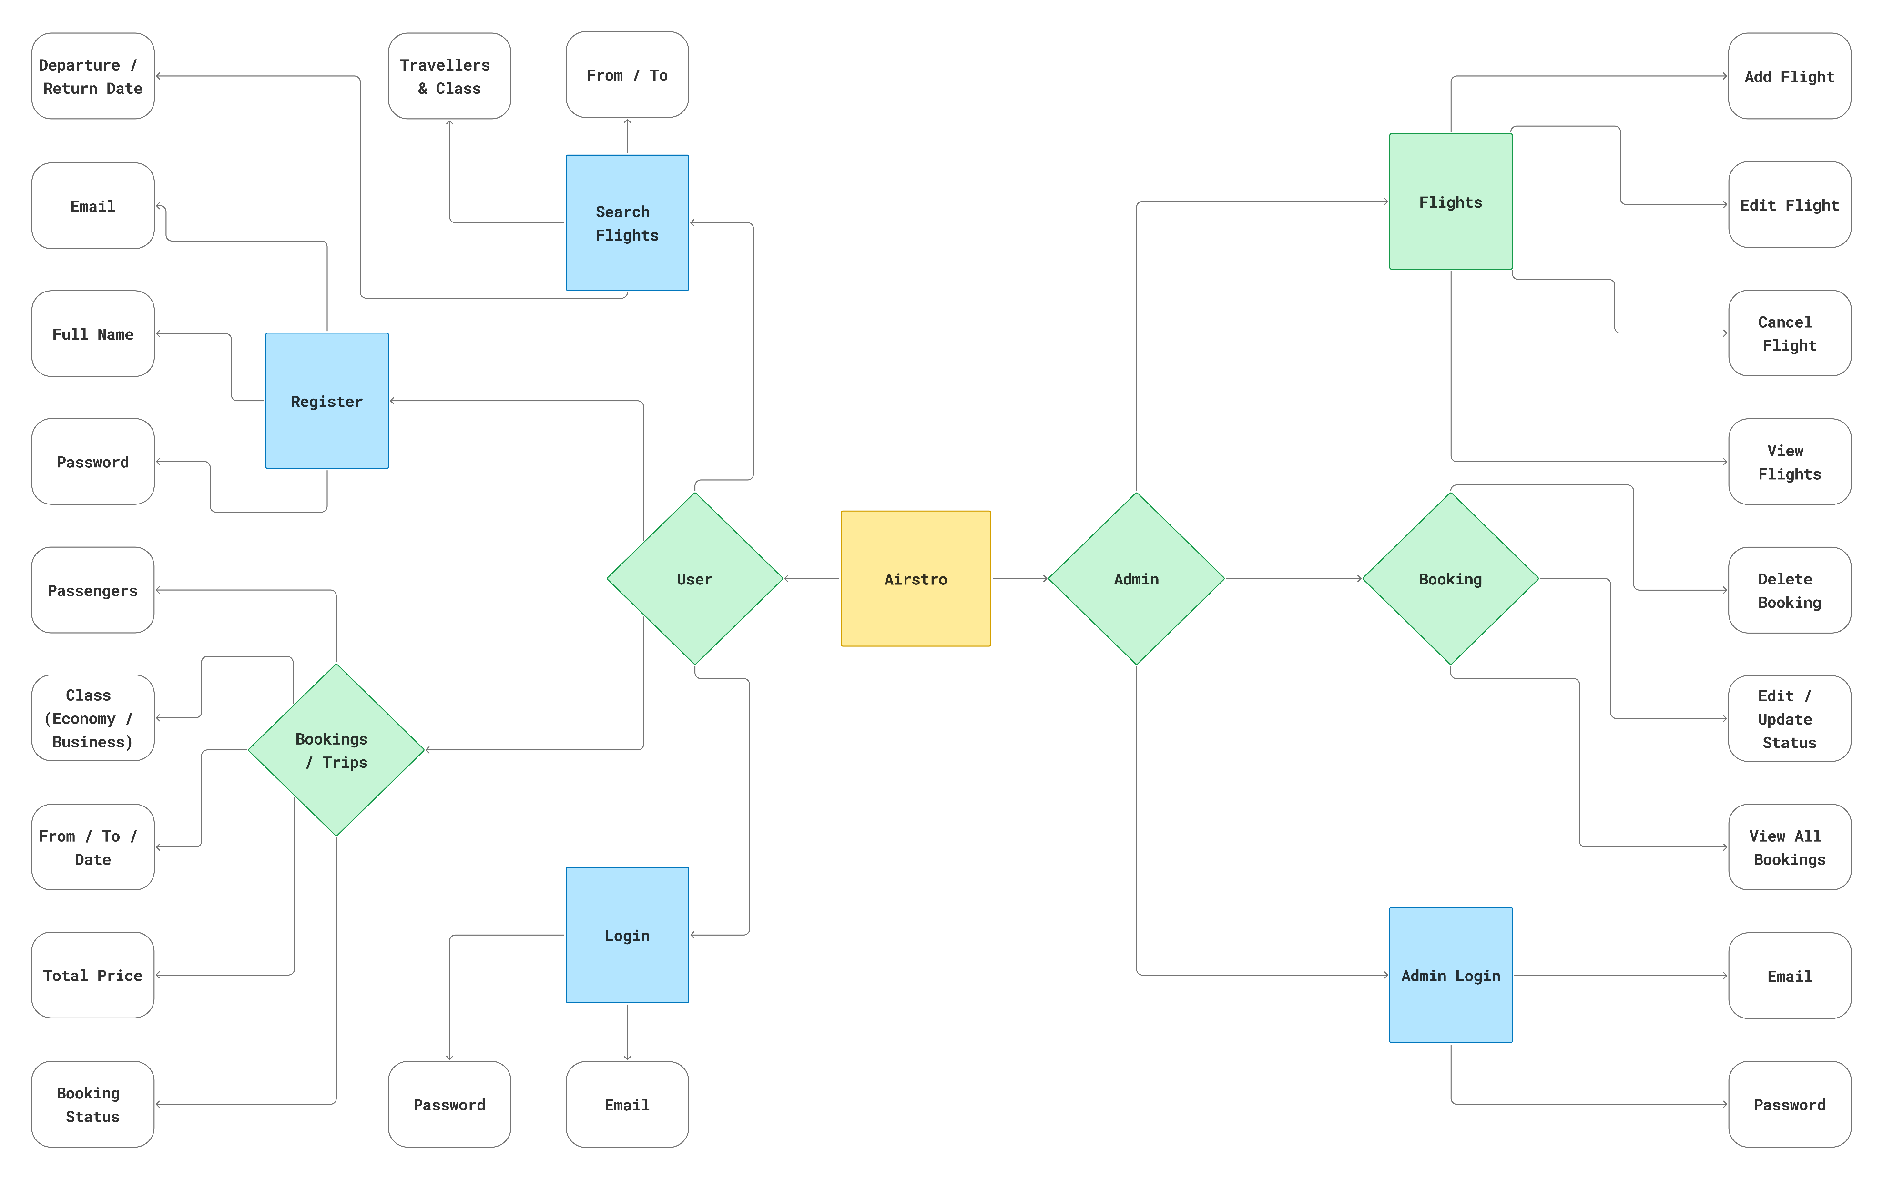
ER Diagram

Slide 13
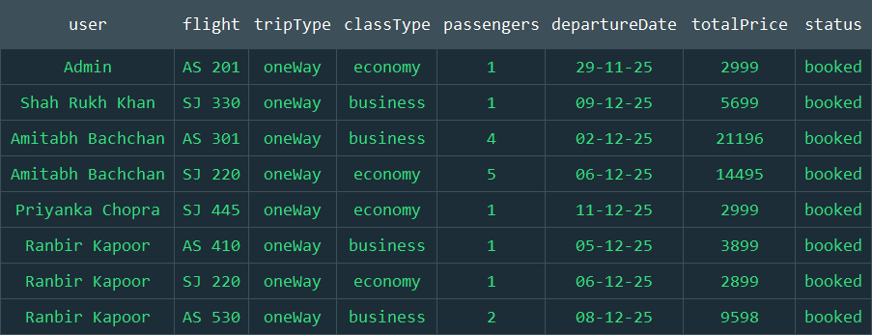
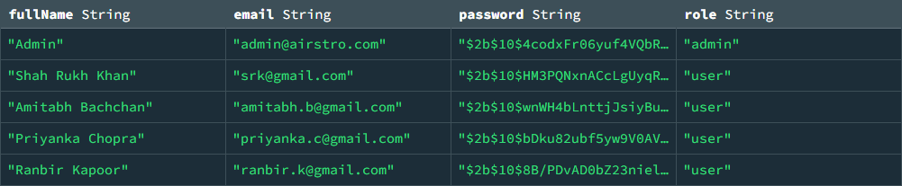
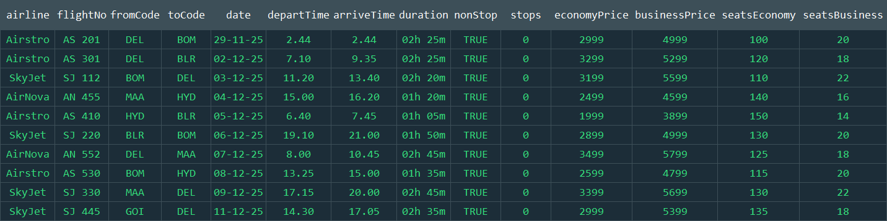
User / Admin Table
Flight Table
Bookings Table

Slide 14
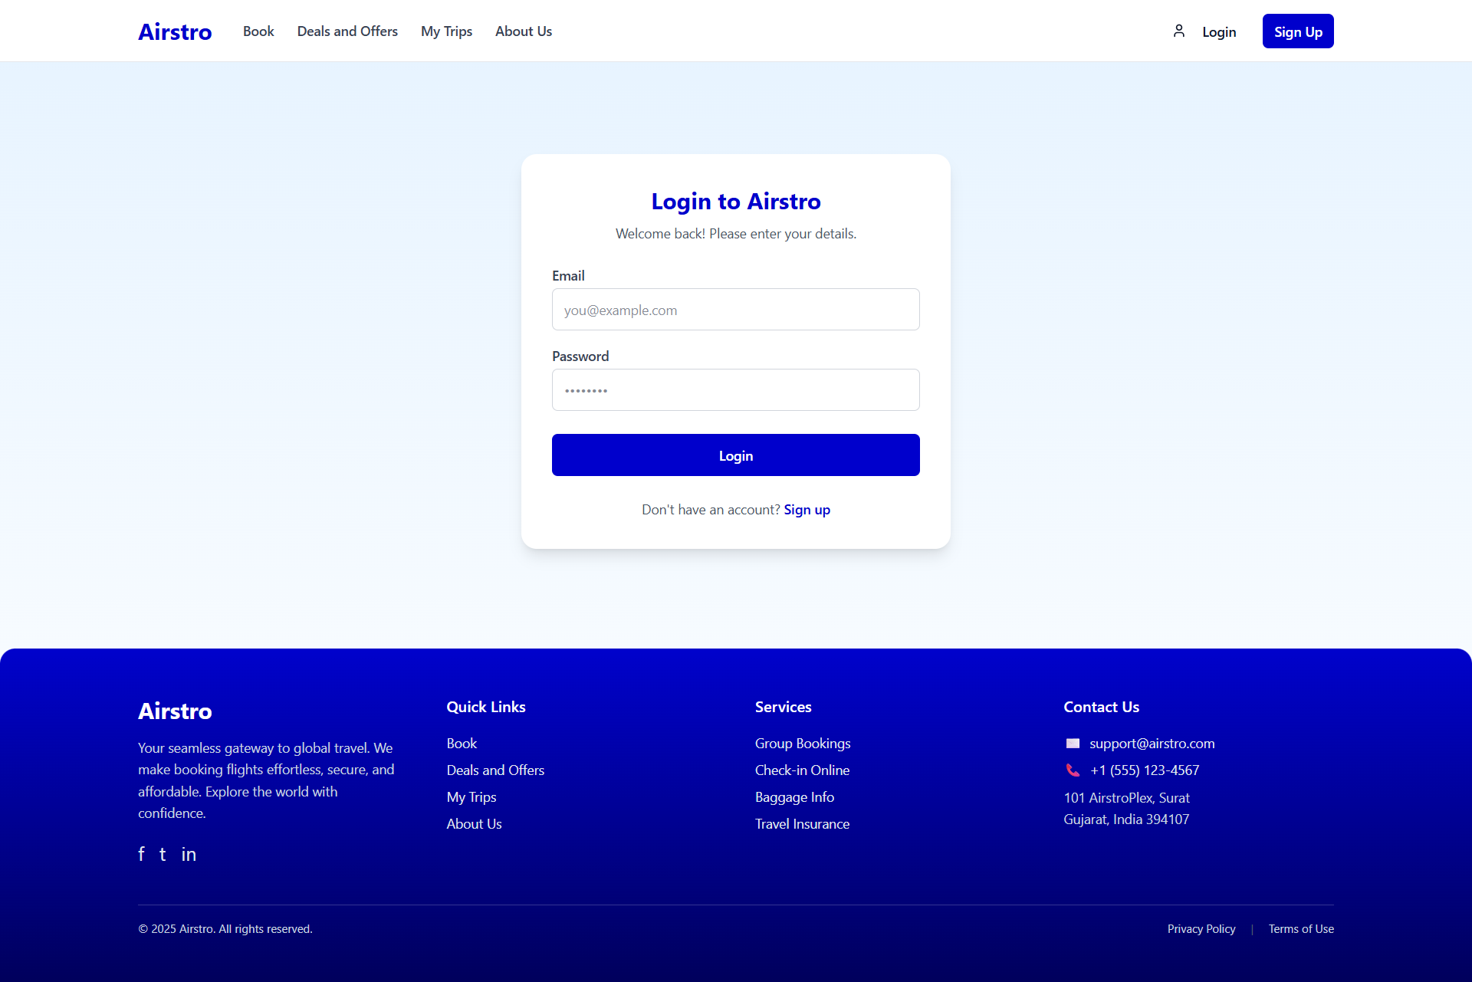
Admin Login

Slide 15
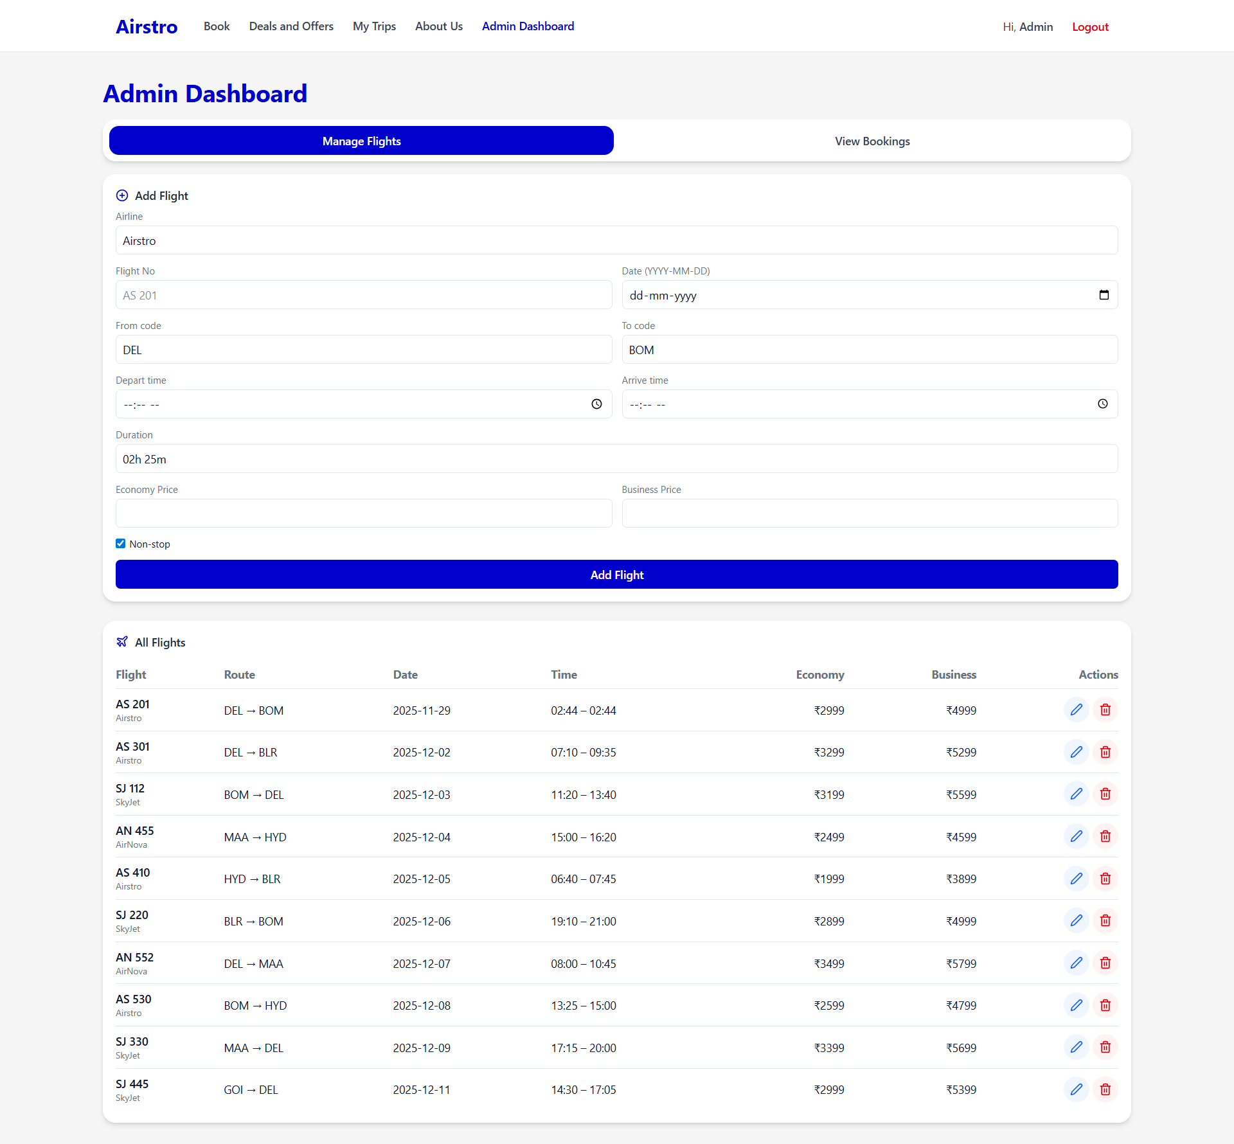
Admin Dashboard

Slide 16
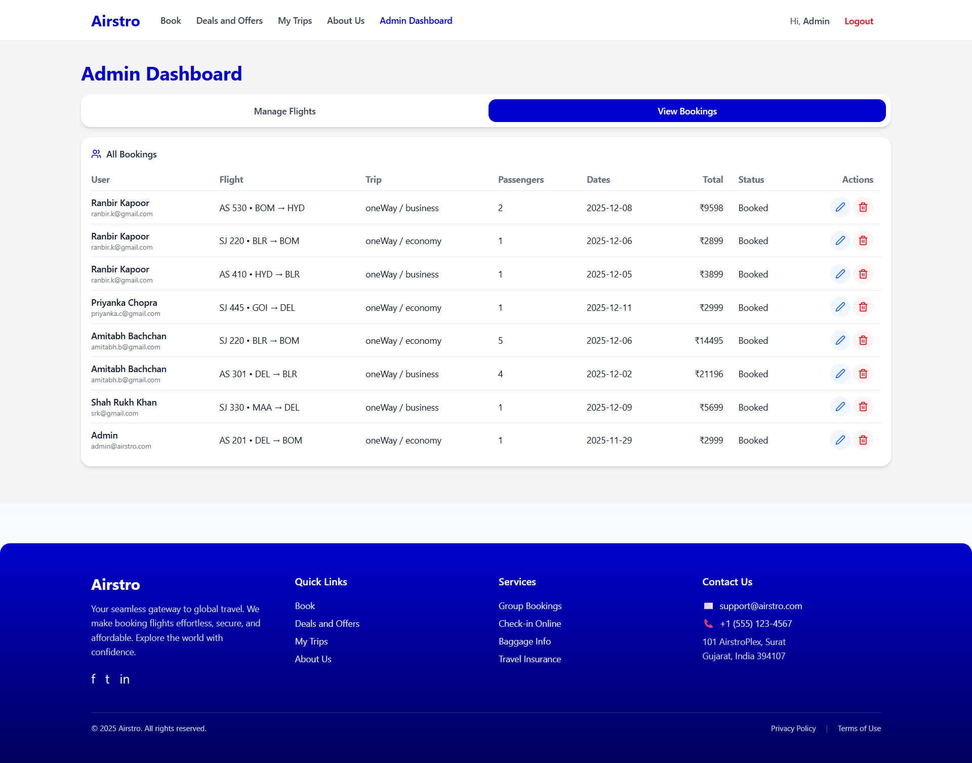
Admin Dashboard

Slide 17
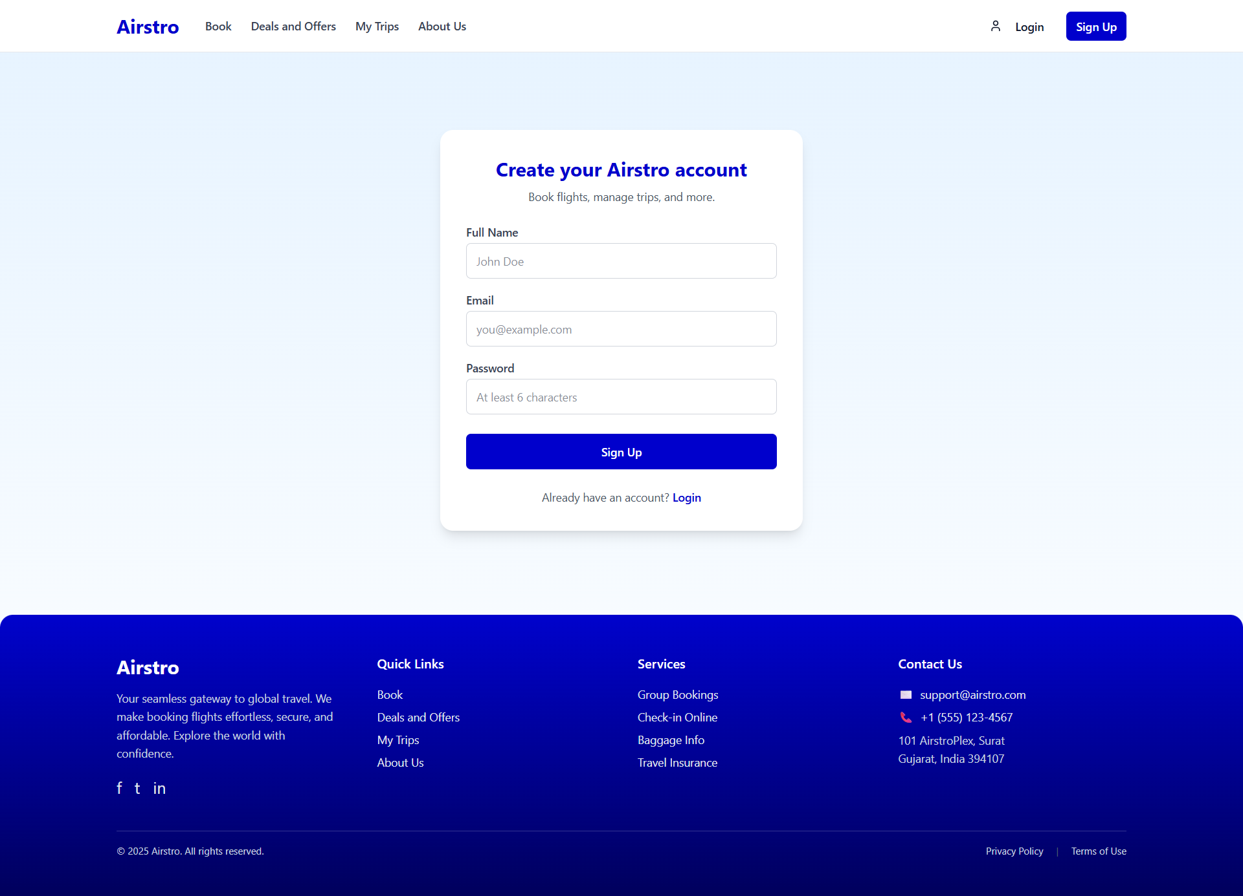
User Sign Up

Slide 18
User Login

Slide 19
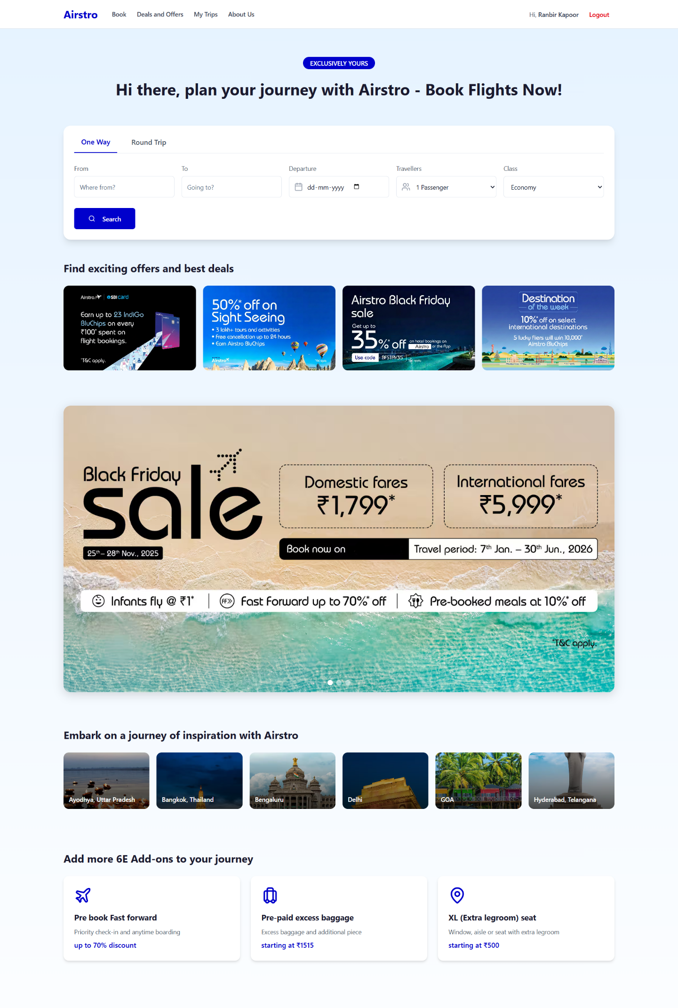

Home Page
Deals and Offer Page

Slide 20
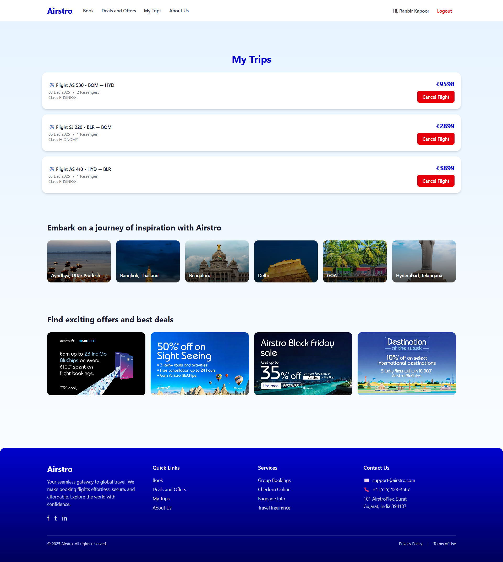
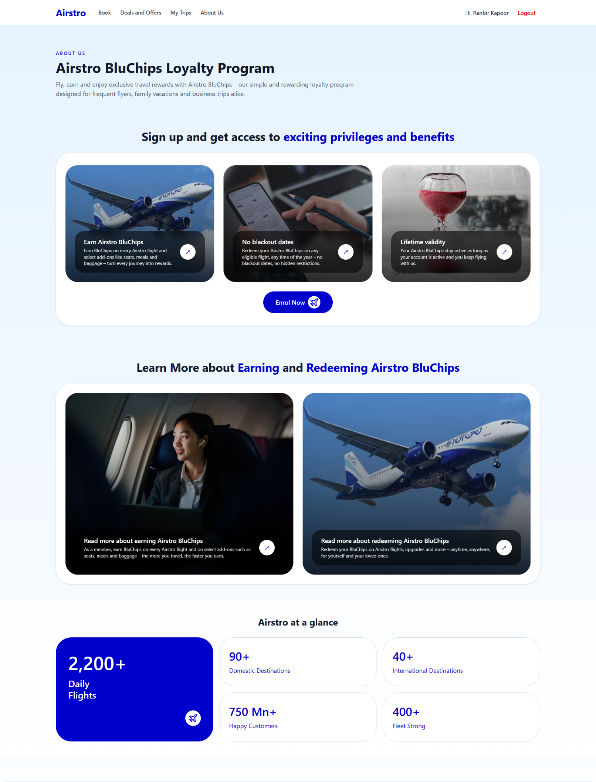
My Trips Page
About Us Page

Slide 21
CONCLUSION
The Airstro – Online Flight Booking System provides a modern and efficient solution for managing airline bookings digitally. It eliminates the need for traditional offline ticket reservations and offers a user-friendly platform where users can easily search flights, book tickets and manage their bookings. The admin can efficiently maintain flight schedules, update information, and oversee bookings through a centralized dashboard. By implementing digital automation, transparency, and role-based access control, Airstro improves the overall passenger experience and simplifies administrative operations. the system has high potential to evolve into a complete and scalable online airline reservation platform.

Slide 22
THANK YOU

